Slide 1
Human Activity Recognition
Edwin Candinegara

Slide 2
RESULT SUMMARY
Excel

Slide 3
FEATURES COMPARISON
Can Smartwatches Replace Smartphones for Posture Tracking?

Slide 4
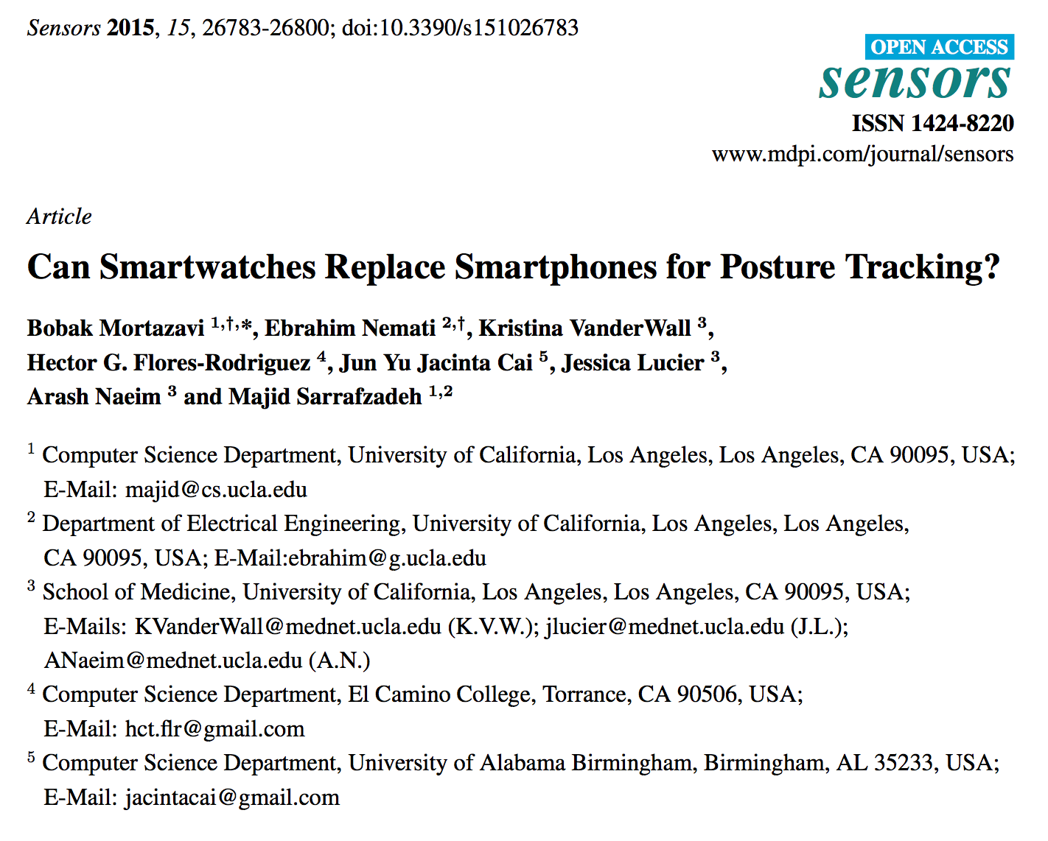

Slide 5
Methods
Sampling Freq: 100Hz, 50Hz, 10 Hz
Algorithm: SVM with PUK Kernel
25 features per axis! → 175 features in total
Feature selection --> 30 features
LOPO
20 subjects, 19-30 years old, supervised study
Left wrist, left pocket
Samsung S4, Samsung Galaxy Gear Smartwatch

Slide 6
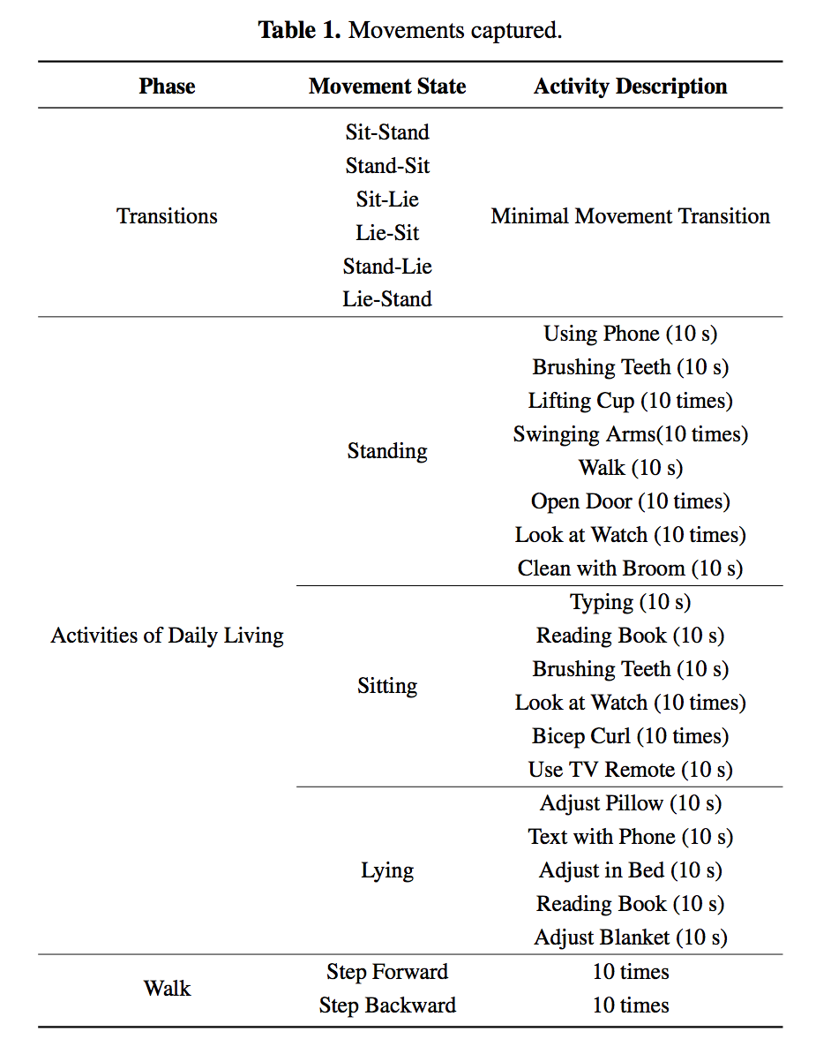

Slide 7
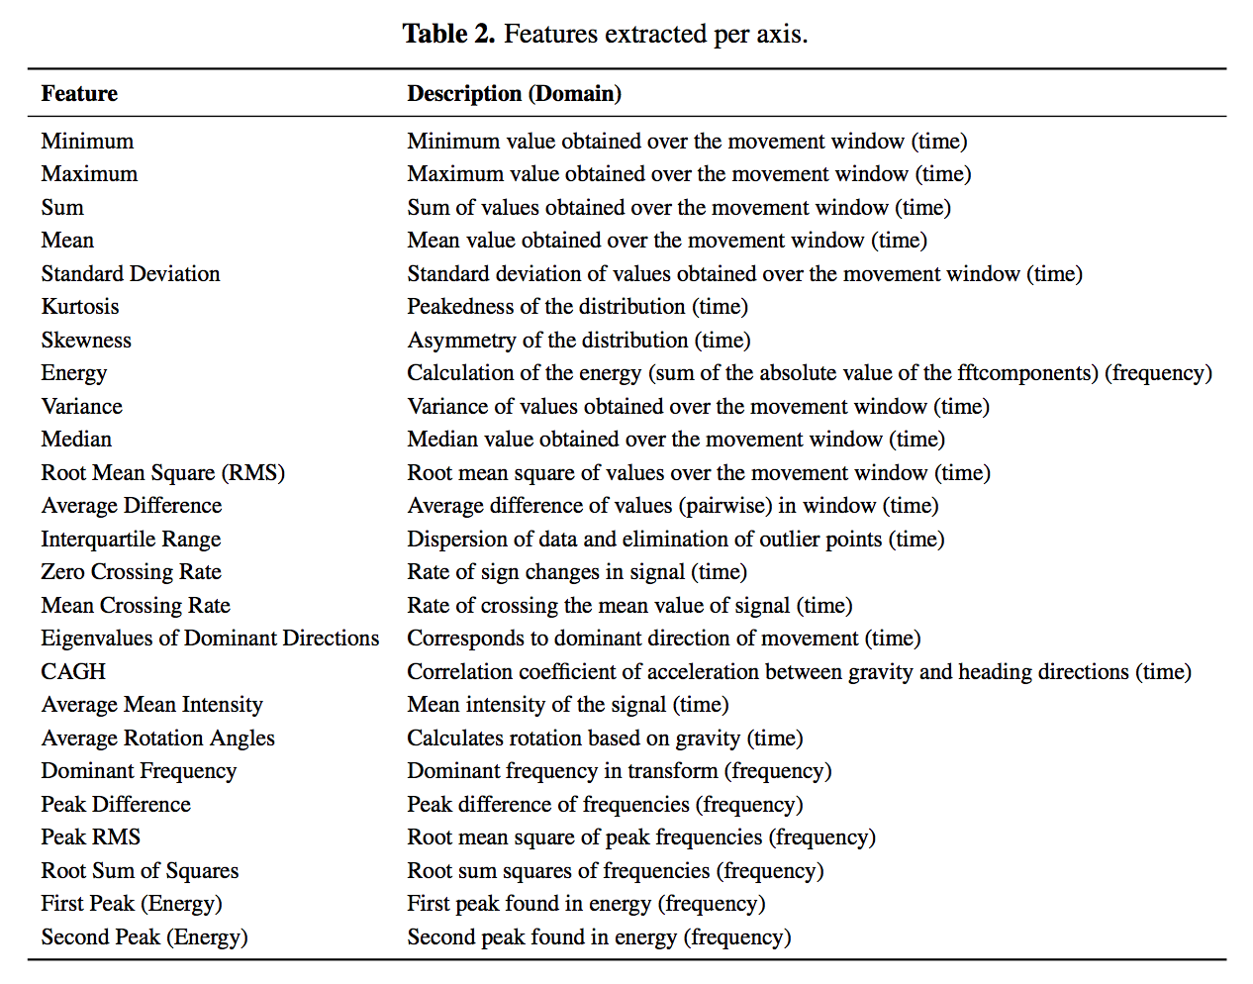

Slide 8
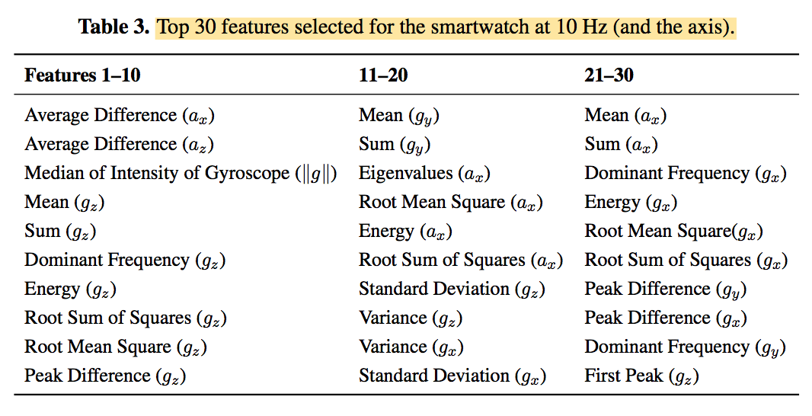

Slide 9
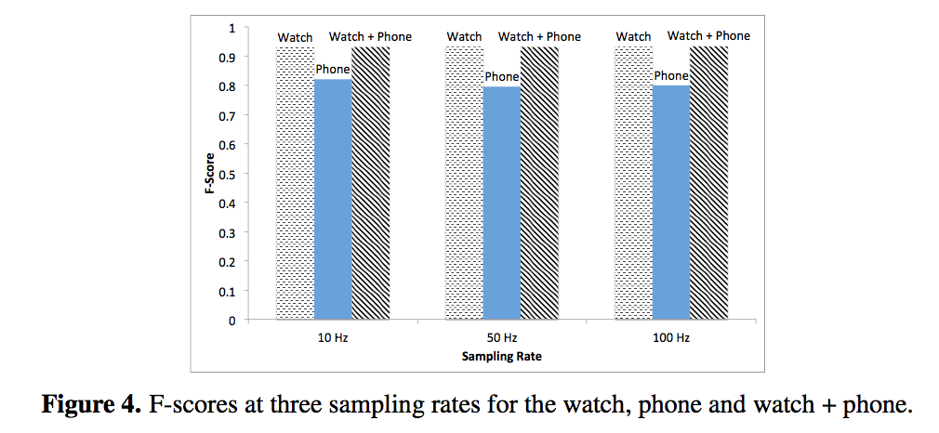

Slide 10
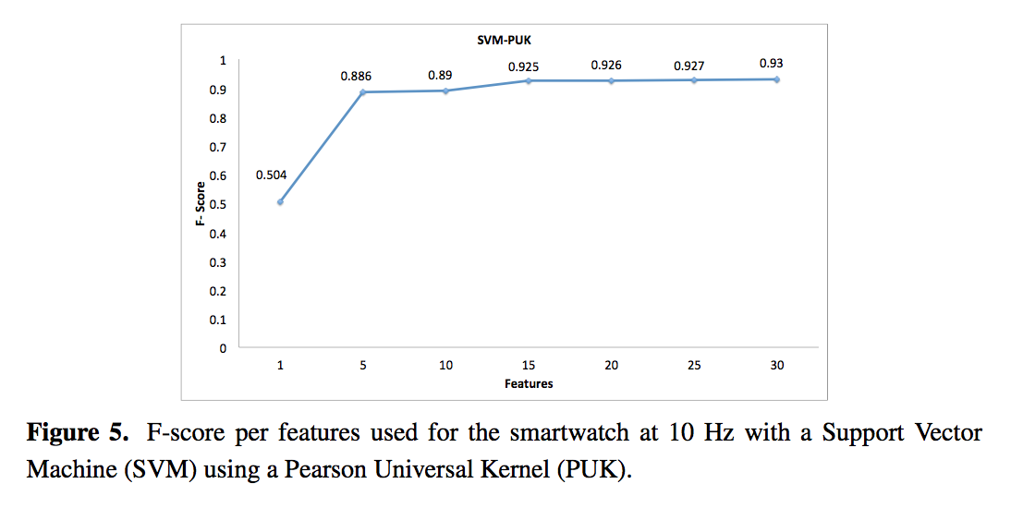

Slide 11
What’s next?
Interim report content?
Trying the mean-0 idea
Features benchmarking

